Slide 1
Employee Data Analysis Using Excel
STUDENT NAME: R. MOHAMMED SAIFULLAH
REGISTER NUMBER: 312211643
DEPARTMENT: BCOM GENERAL
COLLEGE: THIRUTHANGAL NADAR COLLAGE

Slide 2
Employee Performance Analysis Using Excel

Slide 3
AGENDA
1) Using pivot tables to summarize data
2) Types of data required (e.g., employee demographics, tenure, exit reasons)
3) Applying filters and conditional formatting
4)Introduction to regression analysis (if applicable)
5) Drawing insights from the analysis
6) Designing an executive summary report

Slide 4
PROBLEM STATEMENT
The company is experiencing a concerning level of employee turnover, and management needs to understand the underlying factors contributing to this issue. Specifically, there is a need to

Slide 5
PROJECT OVERVIEW
An Employee Attrition Analysis project using Excel involves collecting and organizing data on employee turnover, analyzing patterns and trends, and creating visualizations to identify key factors contributing to attrition. The goal is to uncover insights that can inform strategies to improve retention and address underlying issues. Key steps include data cleaning, descriptive and statistical analysis, and presenting findings with actionable recommendations.

Slide 6
Who are the end users?
HR Managers
Senior Leadership
Recruitment Teams
Department Heads
Data Analysts:

Slide 7
OUR SOLUTION AND ITS VALUE PROPOSITION
Our Employee Attrition Analysis using Excel helps organizations identify patterns and trends in employee turnover. By leveraging Excel’s data analysis tools, we provide insights into key factors influencing attrition and actionable recommendations to reduce it. This solution enhances decision-making, improves retention strategies, and ultimately boosts organizational stability and performance.

Slide 8
DATA SET DESCRIPTION
The dataset includes records of employees with variables such as Employee ID, Hire Date, Termination Date, Reason for Leaving, Department, Job Title, Tenure, Performance Rating, Age, and Salary. It captures detailed information to analyze employee attrition and its contributing factors. Data types vary from dates and text to numeric values.

Slide 9
THE "WOW" IN OUR SOLUTION
The "wow" in our solution lies in its ability to transform complex data into clear, actionable insights effortlessly. With intuitive dashboards, predictive modeling, and visual analytics, it empowers you to proactively address attrition and enhance employee retention strategies effectively.

Slide 10
MODELLING
To analyze employee attrition in Excel, first collect and clean your data. Use pivot tables and charts to summarize and visualize trends. Calculate attrition rates and perform trend analysis with functions like `AVERAGE` and `TREND`. Analyze correlations between factors using the `CORREL` function and create dashboards for clear reporting. Use insights to identify retention strategies.

Slide 11
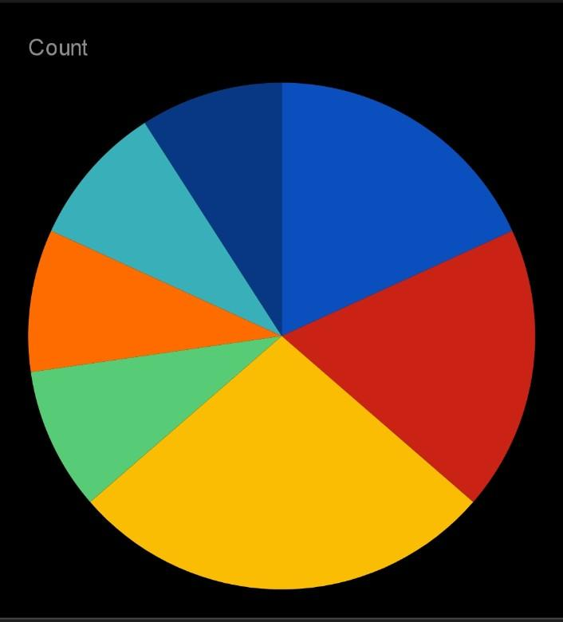
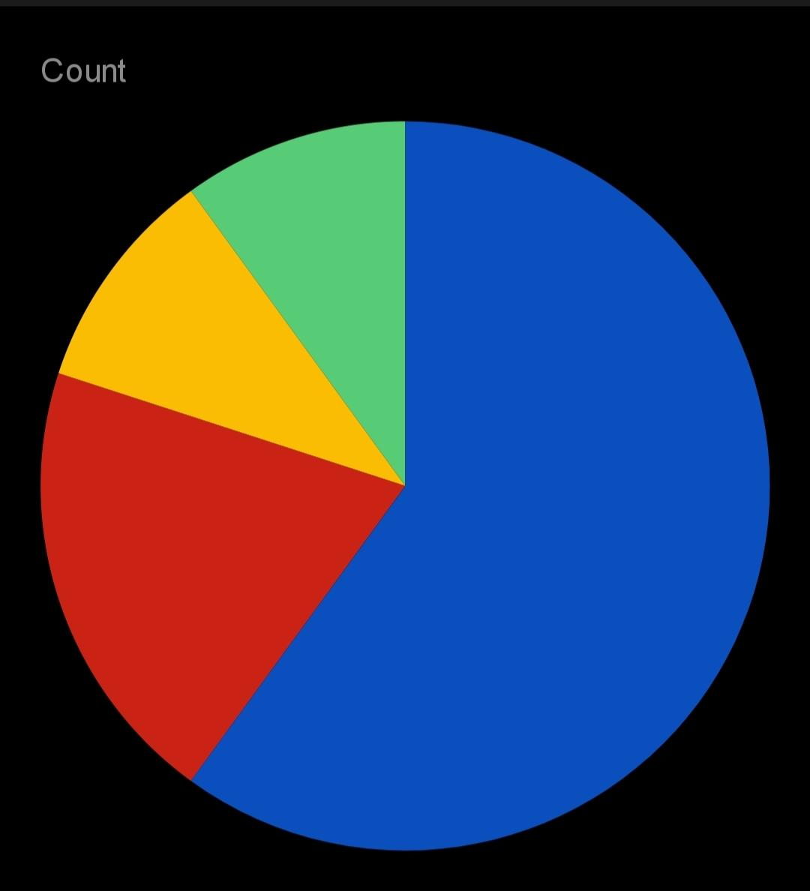
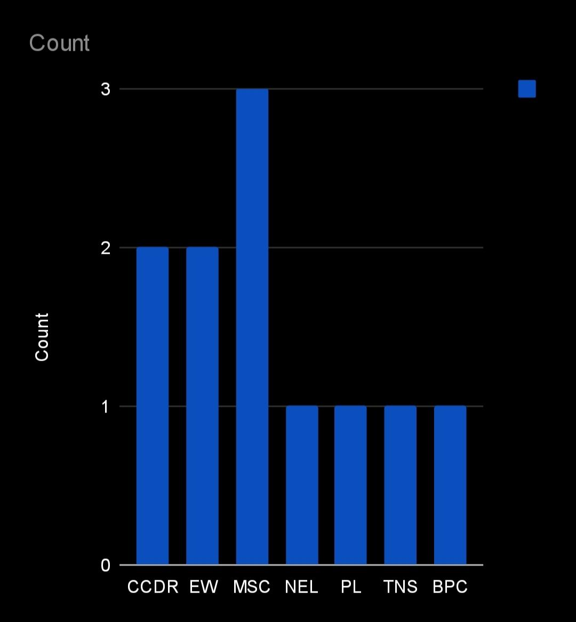
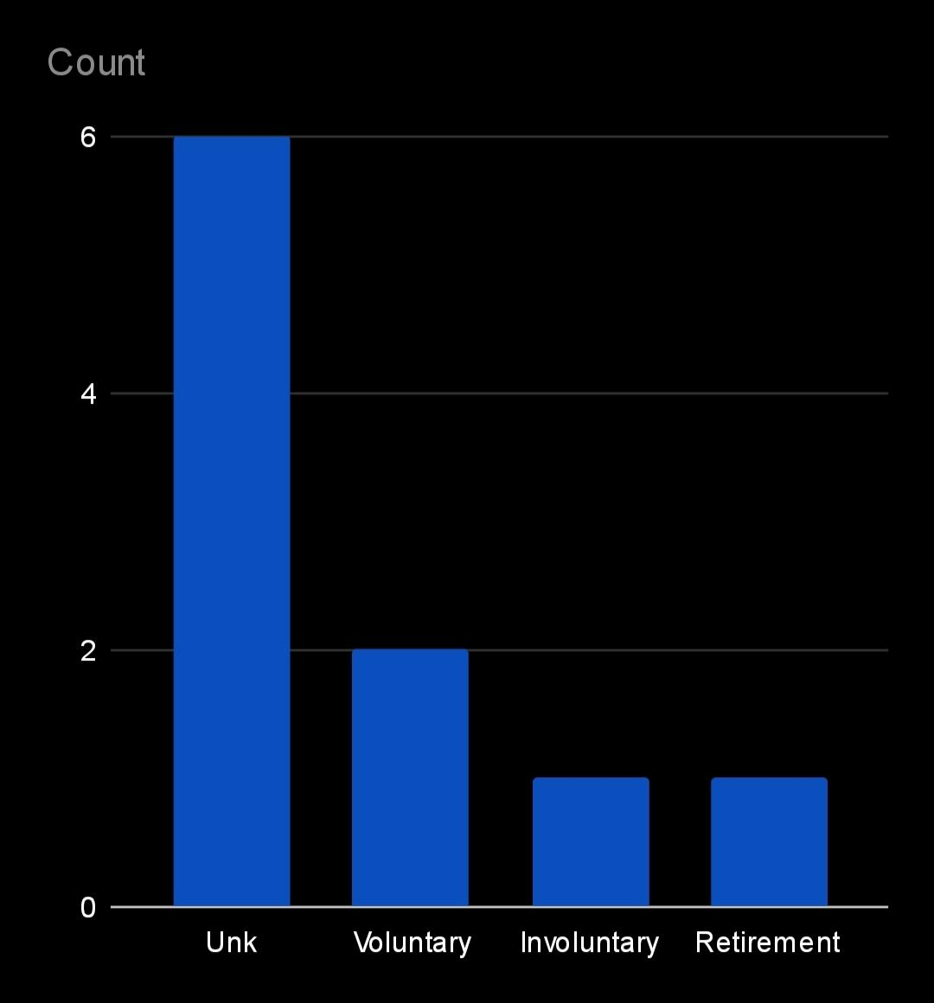
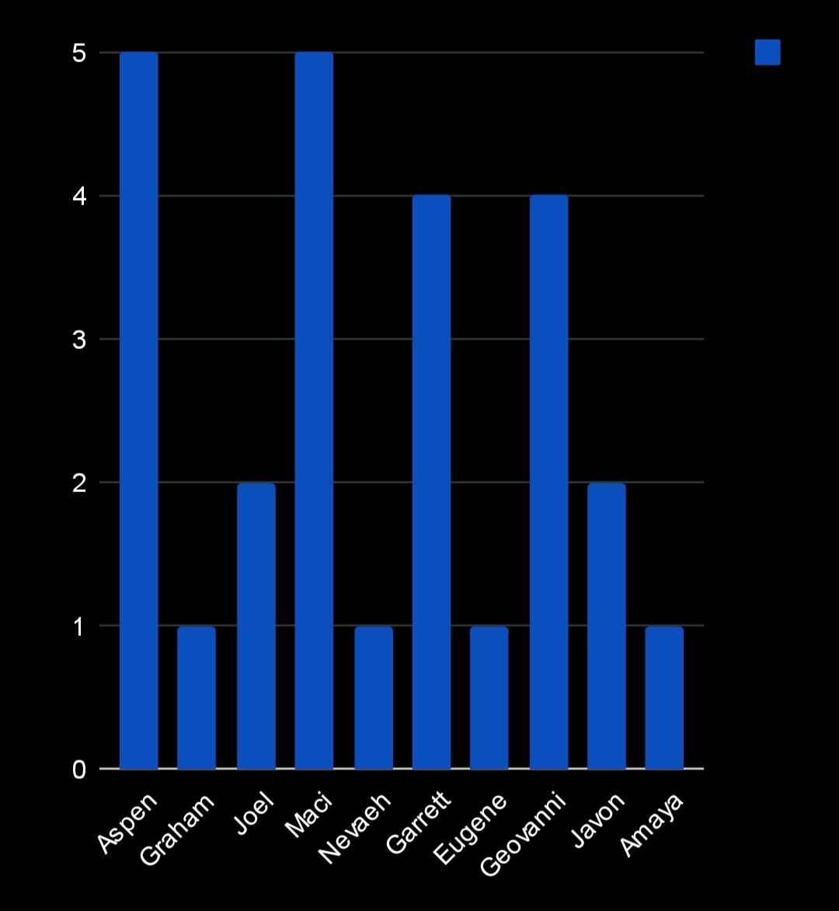
RESULT

Slide 12
conclusion
Analyzing employee attrition using Excel reveals key patterns and insights into workforce turnover. By examining factors such as tenure, department, and reasons for departure, companies can identify areas for improvement and develop targeted retention strategies. Data visualization tools in Excel help in understanding trends and forecasting future attrition rates.

